Slide 1

ChatGPT: 有效搜尋、運用、及引用文獻 —
ChatGPT: Effective Search, Utilization, and Citation of Literature
張瑞釗
Reed Chang
中科院顧問
May 28, 2024
PhD Association

Slide 2

CONTENT
動機與啟發: Motivation and Inspiration
文獻探討的重要性: The Importance of the Literature Review
取得文獻: Acquiring Literature
引用參考文獻: Citing References
運用文獻: Utilizing Literature
搜尋供參考和投稿的期刊: Searching for Journals for References and Submission
心得與成果: Takeaways and Outcomes

Slide 3
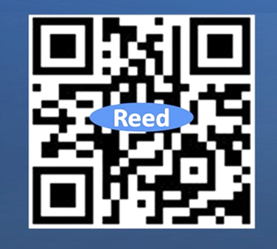
延伸閱讀
Further Reading
文獻回顧 – Literature Review
最新信息
懷念謝老師 – Remembering Dr. Hsieh
精彩遺澤，留傳永遠 – The legacy Dr. Hsieh left behind outlasts time
From the editors. Publishing in AMJ-Part 3: setting the hook. Academy of Management Journal, Vol. 54, No. 5, 873-879. 2011
荼蘼不爭春，寂寞開最晚, https://wordpress.com/post/reedjoe.com/8872
Ferris G. R., Ketchen, D. J., Jr., & Buckley, M. R. (2008). Making a life in the organizational sciences: no one ever said it was going to be easy. Journal of Organizational Behavior, 29, 741–753.
GTC March 2024 Keynote with NVIDIA CEO Jensen Huang (CEO黃仁勳)
認識ChatGPT —Understanding ChatGPT

Slide 4
動機與啟發
Motivation and Inspiration
靠著時間和毅力，駱駝終將跨過無垠的沙漠。
With time and perseverance, a camel would eventually trek across the borderless desert.
攻讀博士學位是一場馬拉松，不是短跑。
Pursuing a PhD is a marathon, not a sprint.
如何運用 ChatGPT 4o 在文獻探討方面提升 20% 的功夫，減少 80% 的工夫。
How to use ChatGPT 4o to improve literature review: 20% increase in skill and 80% reduction in time and effort.
親身實踐心得
Personal practical experience insights

Slide 5
文獻探討的重要性
The Importance of the Literature Review
論文前言撰寫
The Introduction Writing for a Thesis
研究動機 (Research Motivation)
研究問題 (Research Question)：
The literature review is crucial in defining the research question:
Delineating what is already known and what remains unknown
Identifying gaps or areas where further investigation is needed.
研究目的 (Research Objective)

Slide 6
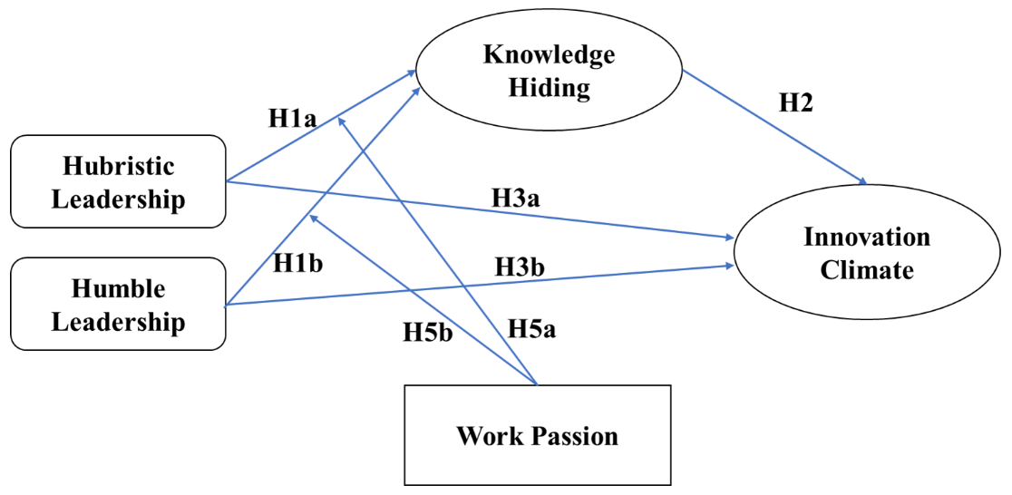
關鍵詞 - Keywords
領導
創新氛圍
知識隱藏

Slide 7
取得文獻
Acquiring Literature
利用以下方法及適當的關鍵字和搜索字串，取得與論文或研究主題相關的文獻。
To obtain relevant literature related to your paper or thesis topics, use the following approaches with appropriate keywords and search strings:
ChatGPT 4o: 利用ChatGPT 4o進行精確搜尋，可取得相關學術論文的全文
Using ChatGPT 4o to precisely search for accessing full texts.
Google Fishing (谷哥釣魚): 直接使用Google搜尋公開可下載的研究論文。
Use Google to directly search for and download openly accessible papers.
Semantic Scholar: 使用Semantic Scholar探索高品質的研究論文及其引用網絡。
Leverage Semantic Scholar to discover high-quality research papers and explore their citation networks.
Google Scholar: 使用Google Scholar搜索廣泛的學術文章和書籍。
  Use Google Scholar to search for and access a comprehensive range of academic articles and books.
Online demo

Slide 8
引用參考文獻
Citing References
Active Citing
Passive Citing
主動引用：
撰寫內容前引用：在撰寫主要內容前，使用ChatGPT 4o搜尋/收集相關文獻。
被動引用：
撰寫內容後引用：在撰寫主要內容後，使用ChatGPT 4o搜尋相關文獻。此法除確保論點有充分的支持，比傳統方法更可省下大量時間。
Topic
Citing References
Acquiring Literature
Citing References using
ChatGPT 4o
Citing
References using
ChatGPT 4o
Arguments Need to be Justified
Paper Content

Slide 9
引用參考文獻
Citing References
Active Citing
Passive Citing
Active Citing:
Pre-Content Citation: Using ChatGPT 4o to search for and gather relevant literature before writing the main content
Passive Citing:
Post-Content Citation: After drafting the main content, use ChatGPT 4o to search for relevant literature that supports points. This method helps ensure that arguments are well-supported by credible sources and can save significant time compared to traditional methods.
Topic
Citing References
Acquiring Literature
Citing References using
ChatGPT 4o
Citing
References using
ChatGPT 4o
Arguments Need to be Justified
Paper Content

Slide 10



取得文獻
Acquiring Literature
主動引用：Active Citing
ChatGPT 4o: 利用ChatGPT 4o進行精確搜尋，可取得相關學術論文的全文
Using ChatGPT 4o to precisely search for accessing full texts.
請你提供幾篇已出版有關研發團隊「謙卑領導」的論文。
Could you provide a couple of papers published referring to "humble leadership" in the context of R&D teams?
Here are some published papers that discuss "humble leadership" in various contexts:
“Humble Leadership and Team Innovation: The Mediating Role of Team Reflexivity and the Moderating Role of Expertise Diversity in Teams"
Source: Frontiers in Psychology

Slide 11
取得文獻
Acquiring Literature
被動引用：Passive Citing
大多數文獻認為創新氛圍影響知識隱藏，反之則不然（請搜尋並連結相關文獻）。然而，我強調在研發團隊中「知識隱藏」影響「創新氛圍」（請搜尋並連結相關文獻）。
支持知識隱藏影響創新氛圍的文獻
「知識隱藏：當前研究狀況和未來研究方向」：這篇綜合評論討論了知識隱藏如何對組織績效產生負面影響，包括阻礙創新氛圍。該論文建議，減少知識隱藏可以促進組織內更具創新性和合作性的環境。
Source: Frontiers in Psychology

Slide 12
被動引用：Passive Citing
取得文獻
Acquiring Literature
Most literature argues that innovation climate affects knowledge hiding rather than vice versa (please find and link related literature). However, I emphasize that 'knowledge hiding' affects 'innovation climate' in R&D teams (please find and link related literature).
Literature Supporting the Argument That Knowledge Hiding Affects Innovation Climate
"Knowledge Hiding: Current Research Status and Future Research Directions": This comprehensive review discusses how knowledge hiding negatively impacts organizational performance, including hindering innovation climate. The paper suggests that reducing knowledge hiding can facilitate a more innovative and collaborative environment within organizations.
Source: Frontiers in Psychology

Slide 13
主動引用和被動引用包含雙重意義：
引用方式(見前頁)和引用格式
Active and Passive citing imply a two-fold meaning:
The way we cite (see previous page) and the format we cite
The Format We Cite: APA, MLA, Chicago
APA (American Psychological Association) Style
In-Text Citation Format:
Example: (Smith, 2020)
Reference List:
Example:
Smith, J. (2020). Understanding the Brain: A Comprehensive Guide. Penguin Books.

Slide 14
運用文獻
Utilizing Literature
Transferring Literature (文獻轉換)：
將PDF文獻轉換為Word等可編輯格式，便於閱讀和摘錄
Converting PDF literature into editable formats like Word for convenient reading and excerpting. Use iLovePDF.
使用ChatGPT 4o翻譯、綜整與應用文獻
Translation, Synthesizing, and Applying Literature using ChatGPT 4o
Example:
Ferris G. R., Ketchen, D. J., Jr., & Buckley, M. R. (2008). Making a life in the organizational sciences: no one ever said it was going to be easy. Journal of Organizational Behavior, 29, 741–753.

Slide 15
搜尋供參考和投稿的期刊
Searching for Journals for References and Submission
如何搜尋參考文獻與投稿期刊
How to Search for Journals for References and Submission?
ChatGPT 4o：
  利用 ChatGPT 4o，輸入和研究主題相關的關鍵詞，搜尋適合的投稿期刊。
  Using ChatGPT 4o to enter keywords related to your research topic to search for suitable journals for submission.
  JCR (Journal Citation Reports)：
  利用JCR選擇及評估期刊的影響力和聲譽。
  Utilizing JCR to select and evaluate journals based on their impact and reputation.

Slide 16
搜尋供參考和投稿的期刊
Searching for Journals for References and Submission
參考已發表的文獻 (Referencing Published Literature):
  參考手邊論文的引用部分，看看哪些期刊經常被引用。
  Check the references in your current papers to see which journals are frequently cited.
  同行建議 (Peer Recommendations):
  請教您的指導教授、同事或其他專家，尋求他們對適合期刊的建議。
  Ask your advisors, colleagues, or other experts for their recommendations on suitable journals.
期刊目標和範圍 (Journal Aims and Scope):
  前往期刊的官方網站，查看其目標和範圍，確保研究主題符合期刊要求。
  Visit the official websites of journals to review their aims and scope, ensuring your research aligns with the journal's focus and requirements.

Slide 17
搜尋供參考和投稿的期刊
Searching for Journals for References and Submission
請提供與研發團隊領導相關的前十名社會科學期刊。
Could you provide the top ten social science journals on leadership in the context of R&D teams?
下是經常發表關於研發團隊領導研究的前十名社會科學期刊：
Here are the top ten social science journals that frequently publish research on leadership in the context of R&D teams:
Academy of Management Journal (管理學院期刊)
Leadership Quarterly (領導季刊)
Journal of Product Innovation Management (產品創新管理期刊)
Research Policy (研究政策期刊)
Journal of Organizational Behavior (組織行為期刊)
R&D Management (研發管理期刊)
Journal of Management Studies (管理研究期刊)
Organization Science (組織科學期刊)
Technovation (技術創新期刊)
Industrial and Corporate Change (產業與公司變革期刊)

Slide 18
搜尋供參考和投稿的期刊
Searching for Journals for References and Submission
  JCR (Journal Citation Reports)：
  利用JCR選擇參考和投稿的期刊。
在Journal Citation Reports (JCR)中搜索期刊時，可以篩選SSCI（社會科學引文索引）和SCIE（科學引文索引擴展版）搜尋所有與社會科學及相關跨學科領域相關的期刊。具體操作方法：
登入JCR：登入JCR平台。
按索引篩選：使用篩選選項選擇SSCI和SCIE的期刊。
選擇類別：可以進一步根據特定類別或學科，搜尋和研究領域高度相關的期刊。
審查指標：評估期刊的影響因子、引用指標和其他相關數據，供選擇適於研究主題的期刊。

Slide 19
  JCR (Journal Citation Reports)：
  Using JCR to select journals for references and submissions
搜尋供參考和投稿的期刊
Searching for Journals for References and Submission
When searching for journals within Journal Citation Reports (JCR), you can filter by both SSCI (Social Sciences Citation Index) and SCIE (Science Citation Index Expanded) to encompass all possible journals relevant to social sciences and related interdisciplinary fields. Here’s how you can do this:
Access JCR: Log in to the JCR platform.
Filtering by Index: Use the filtering options to select journals indexed in both SSCI and SCIE.
Selecting Categories: Within the filters, you can further narrow down by selecting specific categories or disciplines relevant to your research. This helps in finding journals that are highly specific to your field of study.
Review Metrics: Evaluate the impact factors, citation metrics, and other relevant data provided for the filtered journals to make informed decisions about where to submit your research.

Slide 20
心得與成果
Takeaways and Outcomes
應用ChatGPT 4o
取得參考文獻、被動引用參考文獻
搜尋供參考和投稿的期刊
應用iLovePDF
轉換文獻成可編輯檔案
ChatGPT 4o觀點
因為神奇，所以迷人，但不可將之神化。
猶如能量不滅定律，生成式是一種轉換，不是無中生有。
必也利其器，方能善其事。
  這段時間以來，我一直在探索 "ChatGPT: 人類如何訓練生成式AI聊天機器人"

Slide 21
心得與成果
Takeaways and Outcomes
Using ChatGPT 4o
Obtaining references and passively citing references
Searching for journals for references and submissions
Using iLovePDF
Converting literature into editable files
Perspectives on ChatGPT 4o
Generative AI is fascinating because of its magical qualities, but we should not idolize it
Like the law of conservation of energy, generative AI is a form of transformation, not creation from nothing.
Only by sharpening the tools can one achieve good results in their work.
  During this time, I have been exploring “ChatGPT: How Humans Train Generative AI Chatbots.”

Slide 22
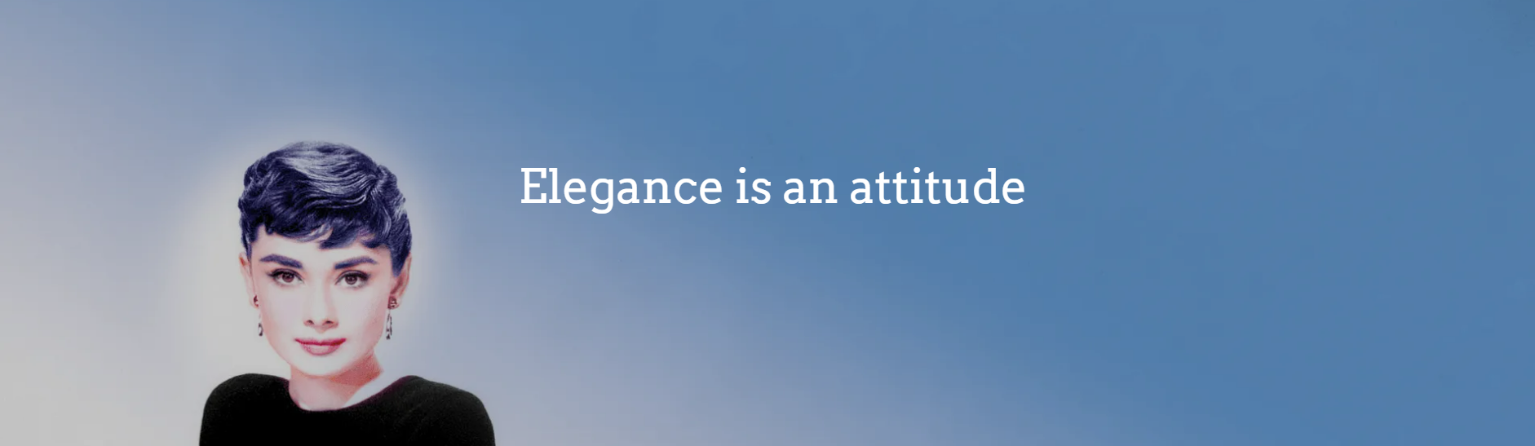
Thank you.
Create an Established and
Elegant writing style.

